Slide 1
Machine Learning Model for Real-life Predictions

Slide 2

Overview
Machine learning models were trained on data gathered from Steamspy
Determine the most popular features that well-selling games provide

Slide 3
Objective of Project
The objective of this project is to train an appropriate machine learning model to be able to predict the relative success of a video game
Based on characteristics such as:
Genre
Categories
Tags
Price

Slide 4
Data Pre-processing
No missing values were found in the dataset
One-hot encoding used to interpret data
Variables were not scaled
Removed outliers

Slide 5
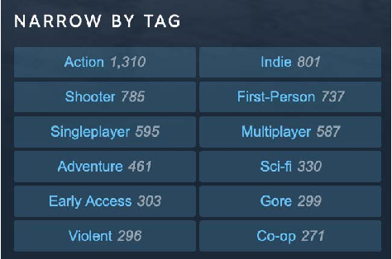
Feature Selection
Chose to prioritize the following columns:
Tags
Categories
Genre
Price
Positive ratings
Negative ratings.

Slide 6
Feature Selection Continued
Dropped achievements column
Filtered out entries that were released before 2013
Dropped entries that did not contain an ASCII value in the title

Slide 7
Data Visualization
Process of creating graphs and charts to help you understand the patterns and trends in the data.
Helps to identify outliers and anomalies in the data.

Slide 8
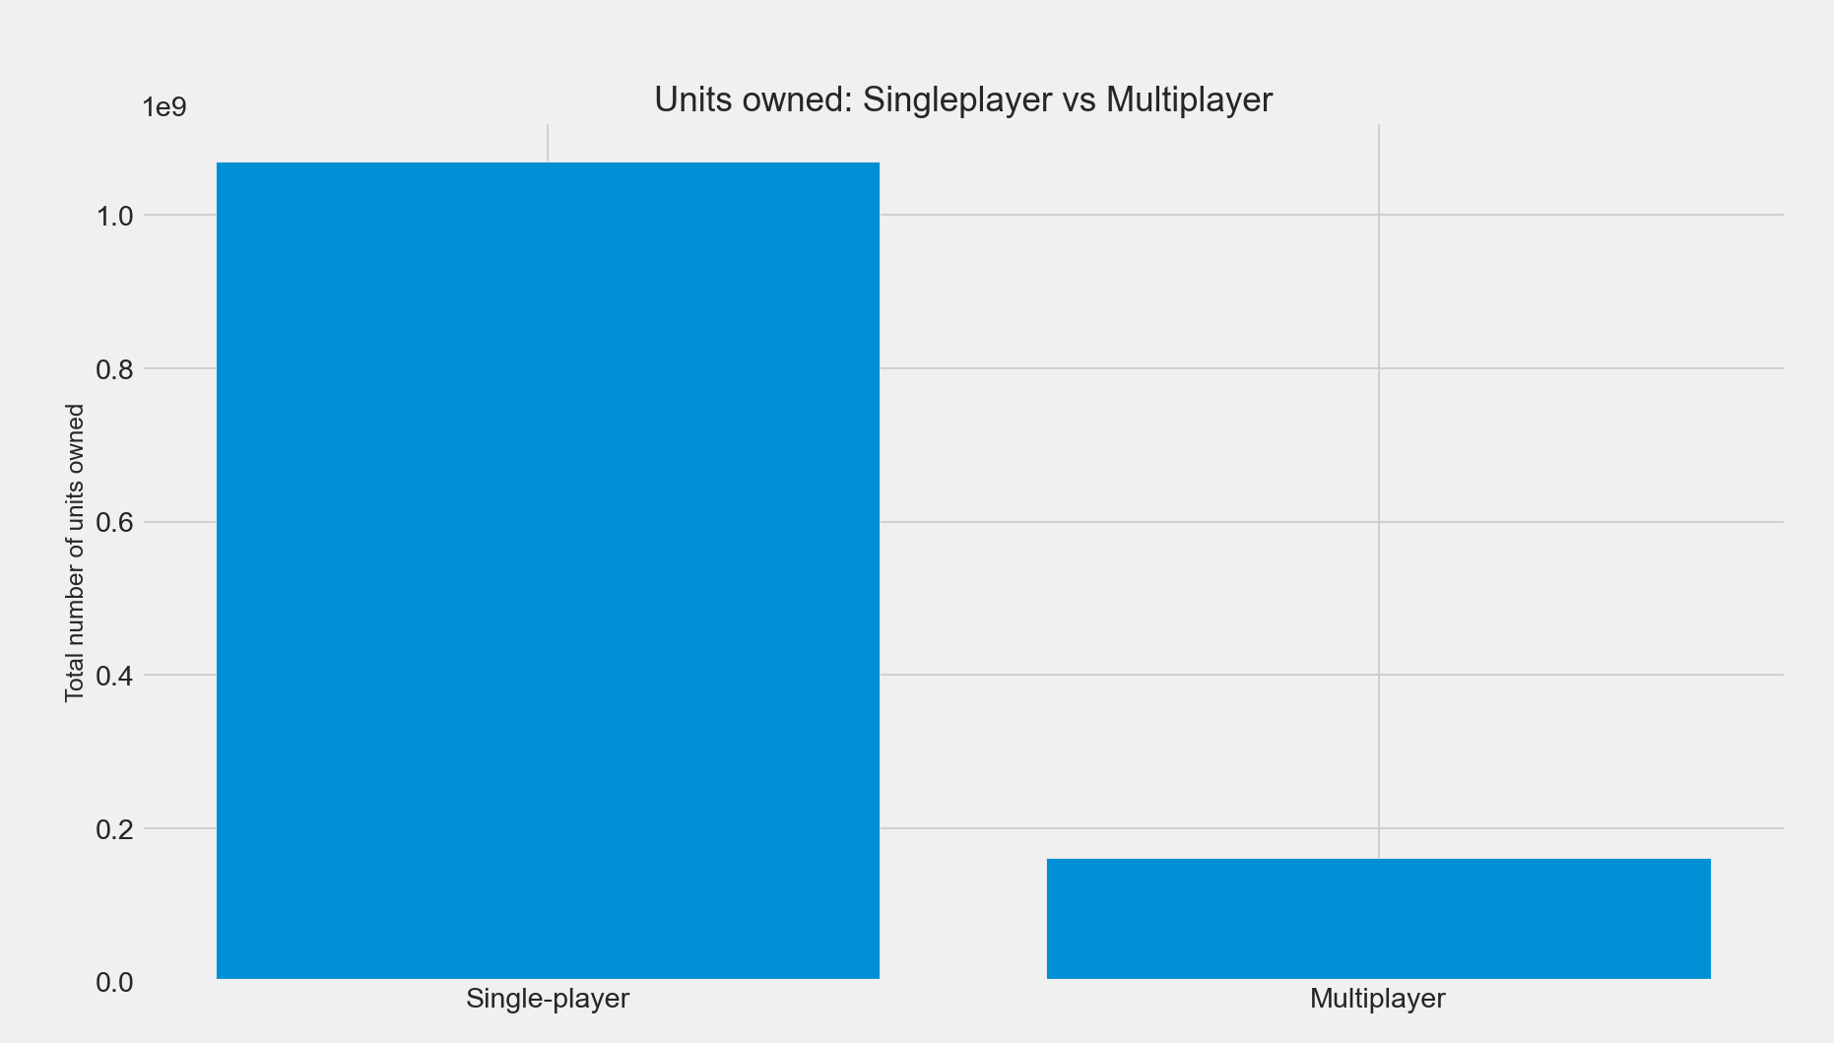

Slide 9
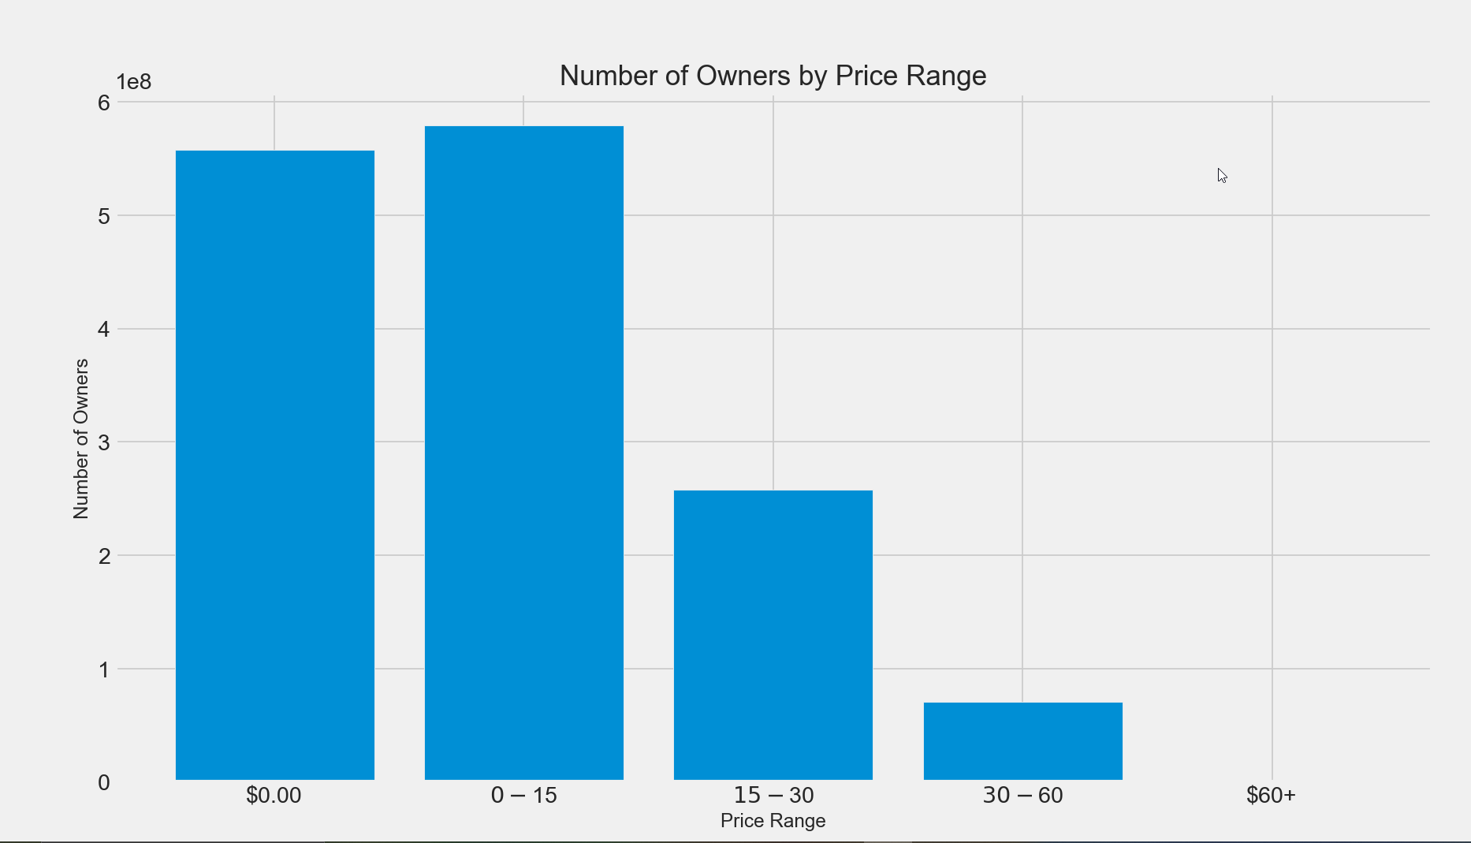

Slide 10
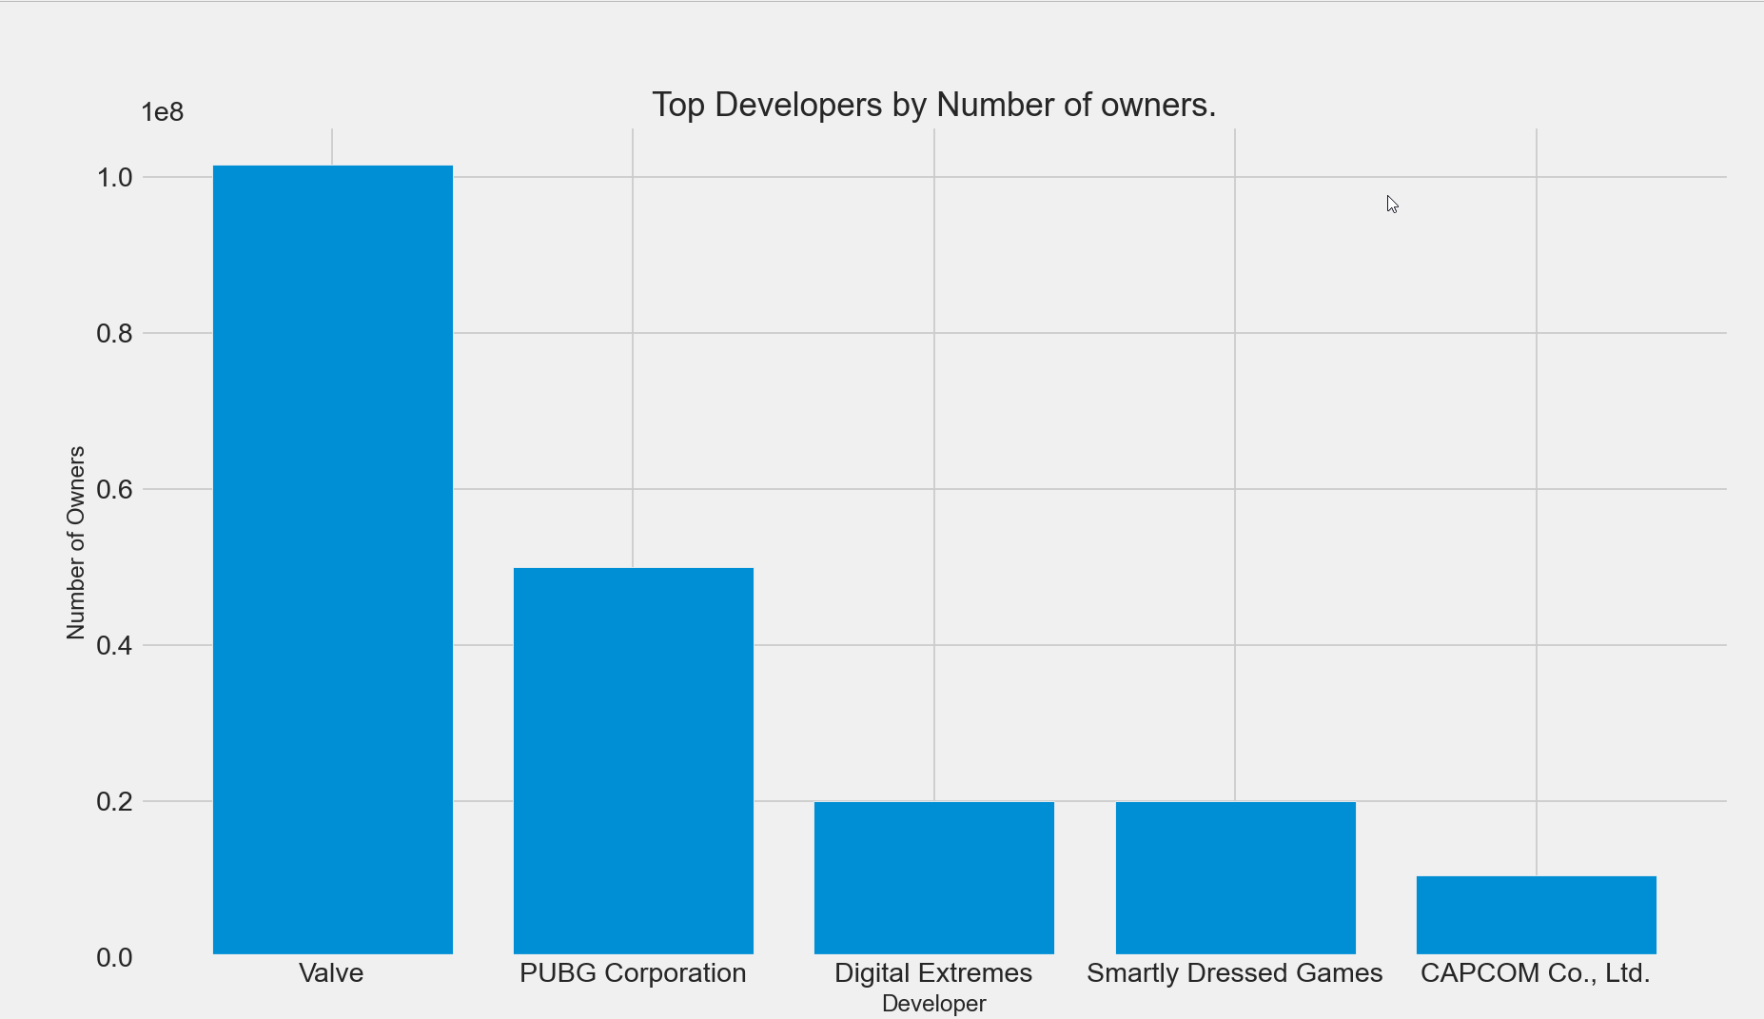

Slide 11
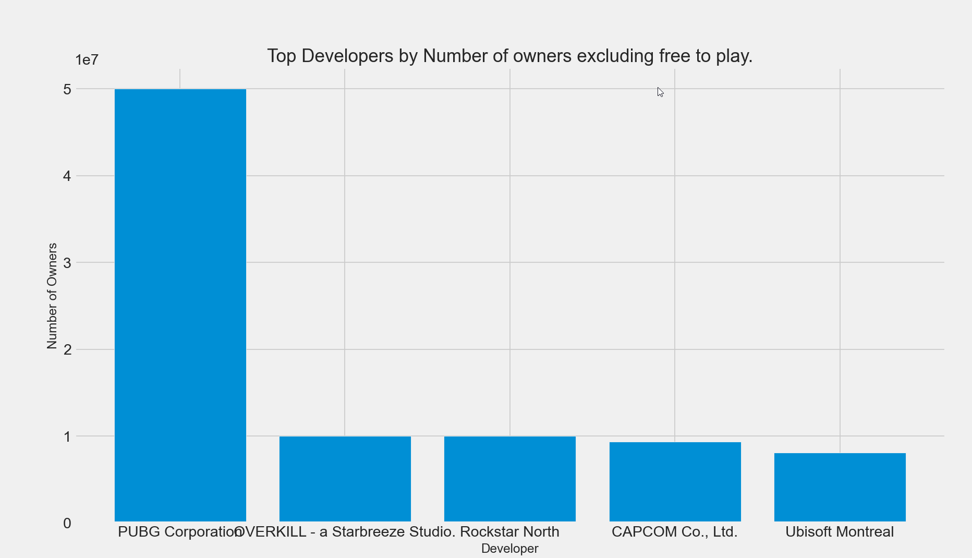

Slide 12
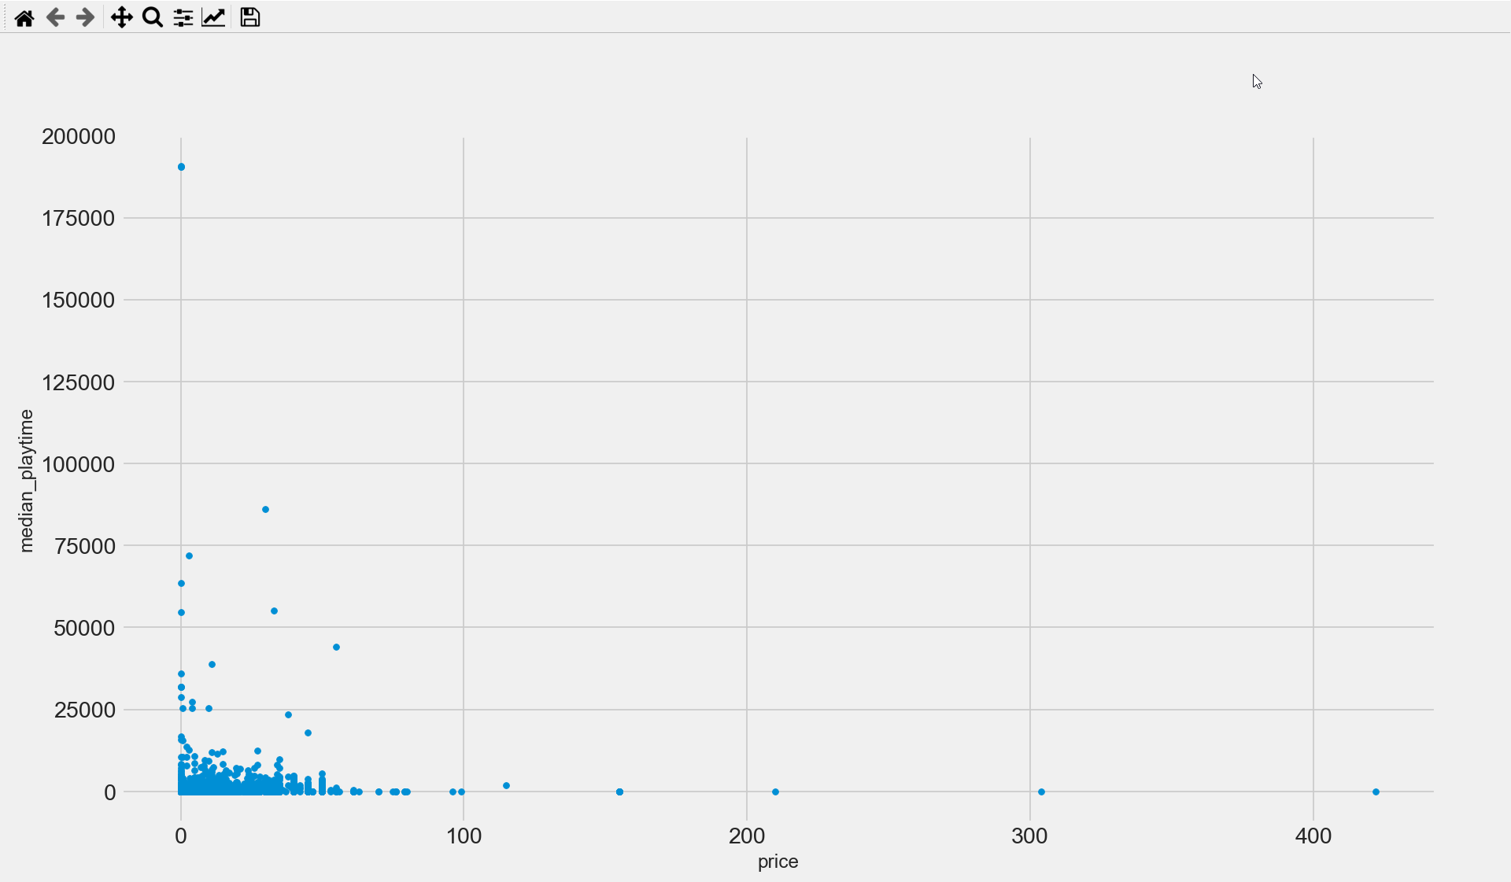

Slide 13

Platform and Machine Configuration Used
A Visual Studio Code environment was used with the Anaconda distribution. Every python script was run on a local machine using the environment.

Slide 14
Model Planning
Different machine learning regression models were used when training on the dataset.
Linear Discriminant Analysis
Logistic Regression
K-Nearest Neighbour
Decision Trees
Lasso Regression
Gaussian Naive Bayes

Slide 15
Model Training
Used sklearn
Models were fitted and trained to predict for the “owners” metric which is an estimated number of the users that own the game on the platform.

Slide 16
Model Evaluation
Model evaluation was done using 4 statistics:
Accuracy / r2 score
F1 score
Precision
Recall
Model optimization was done during the data processing and feature selection phases.

Slide 17
Final Model Building
Comparison graphs were plotted after all model evaluation was done

Slide 18
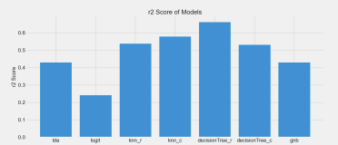

Slide 19
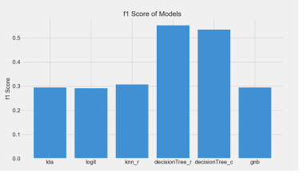

Slide 20
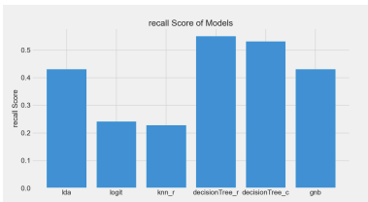

Slide 21
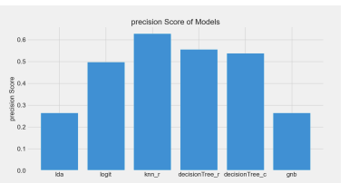

Slide 22
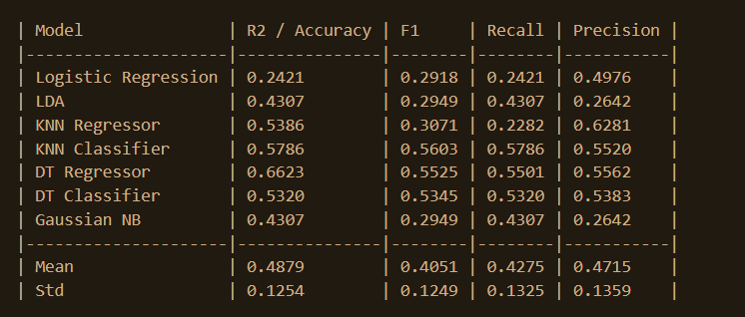
Result Table

Slide 23
Interpretation of Results:
Decision tree model yields the best results of performance metrics.
The final model did not achieve the specified accuracy
Number of owners was an estimated value between a broad range.
An accurate value of sales may provide better performance metrics.
Strong decision tree results may suggest:
Non-linear relationships between variables
Mixture of both categorical and numerical data.

Slide 24
Sensitivity Analysis
Various attempts were made at changing certain aspects of the process in order to obtain the best performance metrics:
Drop entries based on their release date
Experiment with the value of SelectKBest

Slide 25
Future Research
More emphasis should be put on obtaining accurate sales figures.
An alternative solution could be to replace the number of owners column with a sales column.

